Slide 1
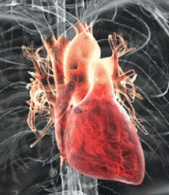
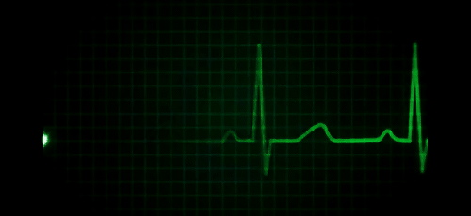
ECG classification task using CNN
Gilad Altshuler
Sagie Badoach

Slide 2
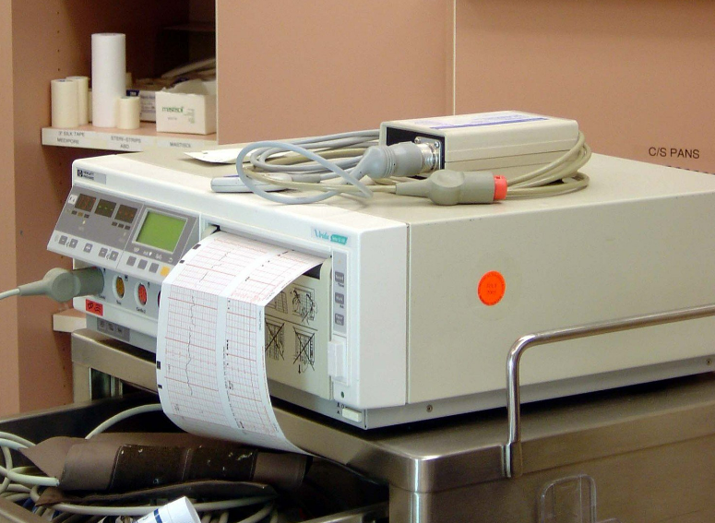
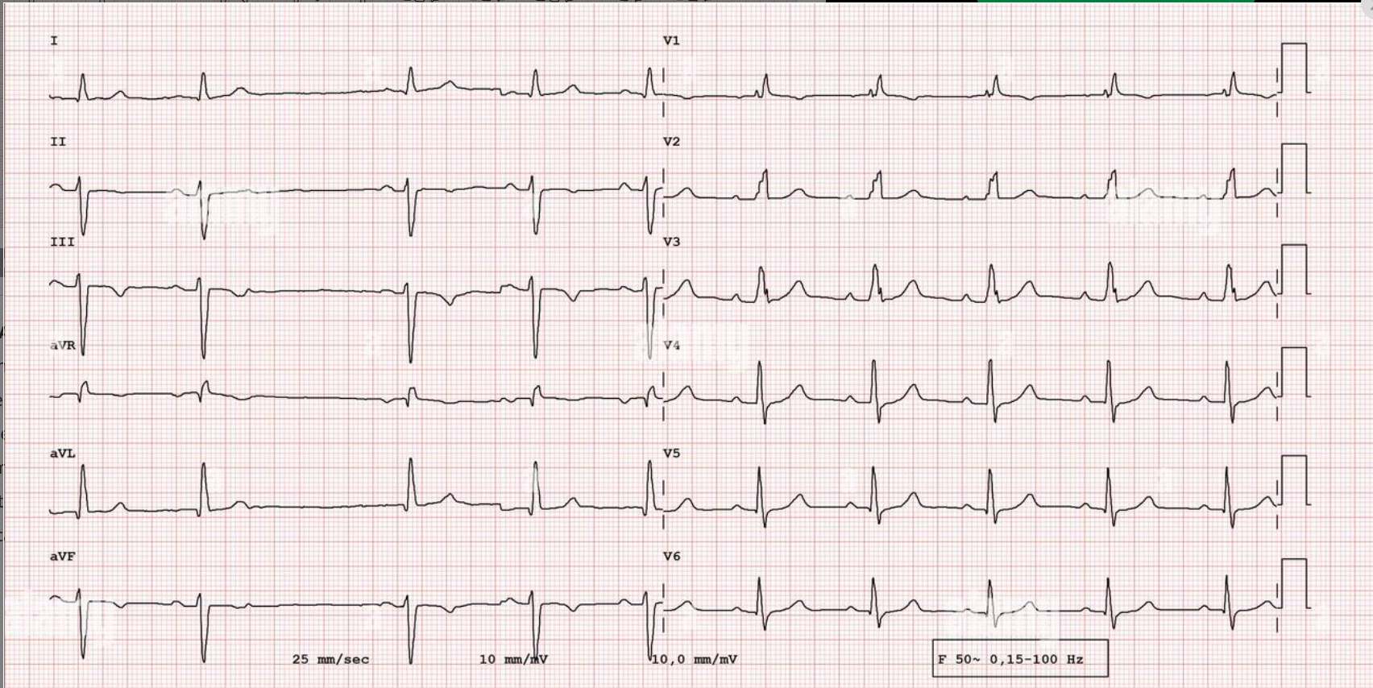
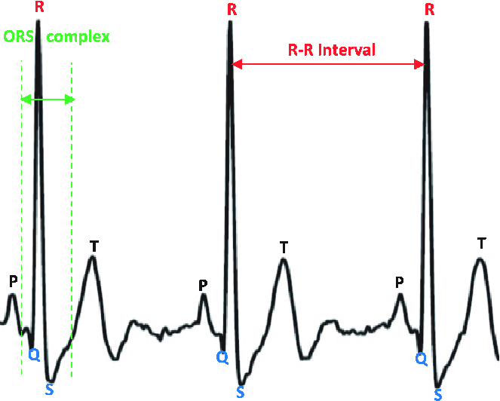
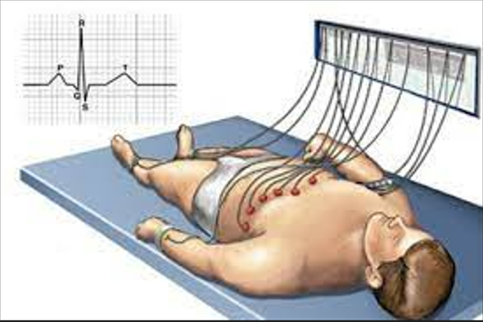
Introduction
Class
N
S
V
F
Q
Heart conditions
Normal Left/Right bundle branch block Atrial escape Nodal escape
Atrial premature Aberrant atrial premature Nodal premature Supra-ventricular premature
Premature ventricular contraction Ventricular escape
Fusion of ventricular and normal
Paced Fusion of paced and normal Unclassifiable
0 | 1 | 2 | 3 | 4
N | S | V | F | Q
Mohammad Kachuee, Shayan Fazeli, Majid Sarrafzadeh, 2018

Slide 3
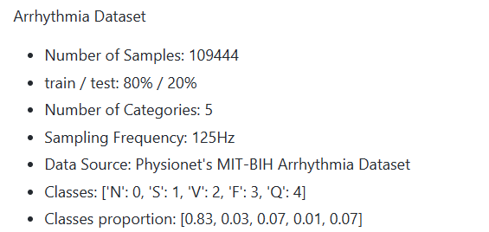
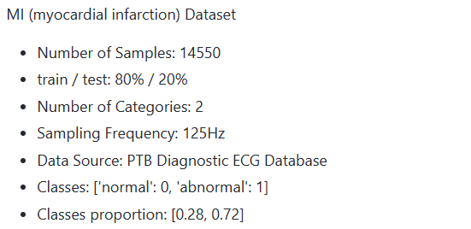
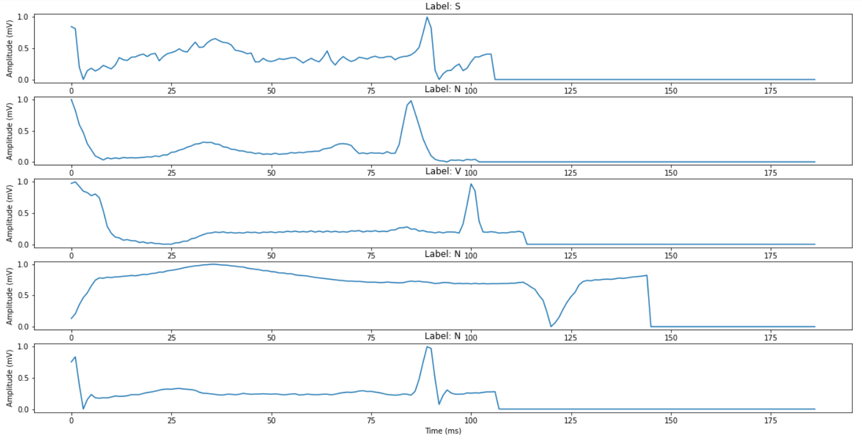
Datasets
Comprised of 2 datasets: MIT-BH and PTB
After preprocessing

Slide 4
Objectives
Design simple yet accurate model to the prediction task
Try to transfer the learnt model for Arrhythmia task for MI task
Comprehend the CNN layers and their meanings

Slide 5
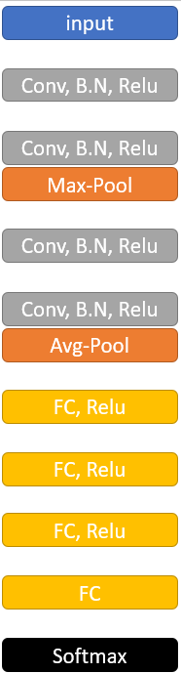
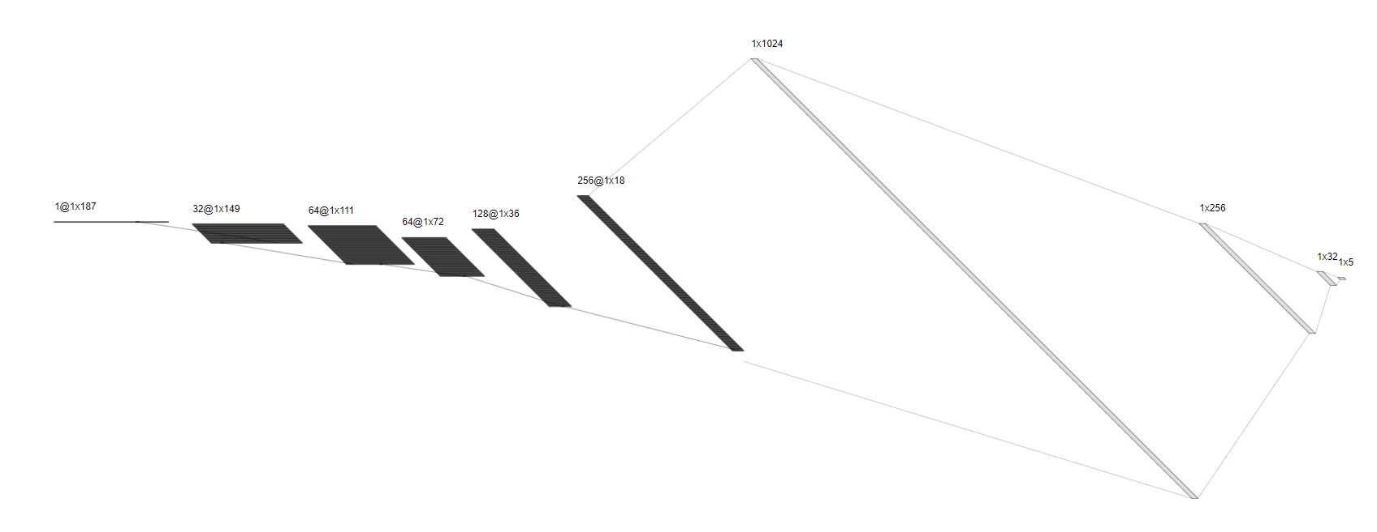
CNN Model proposed

Slide 6
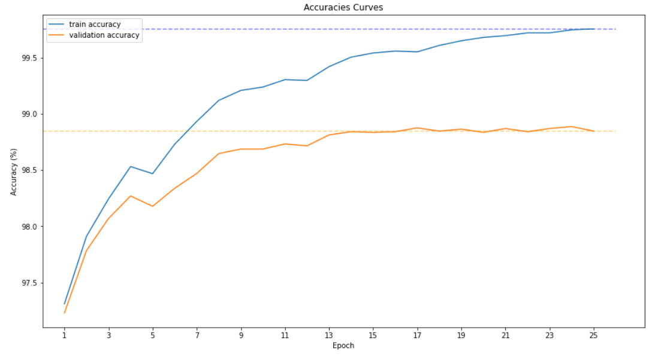
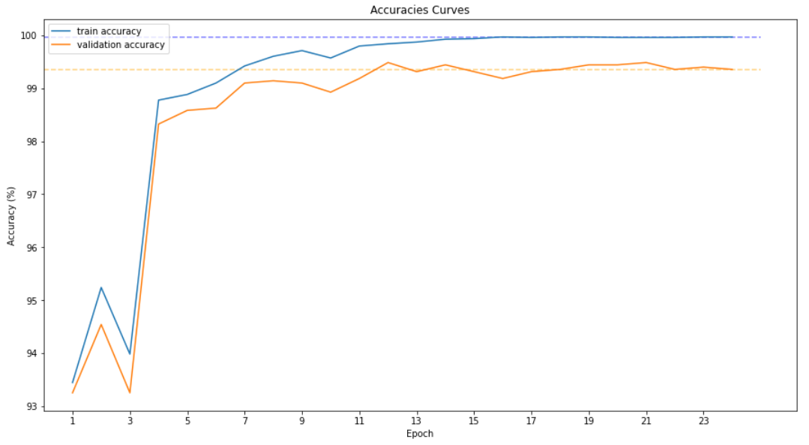
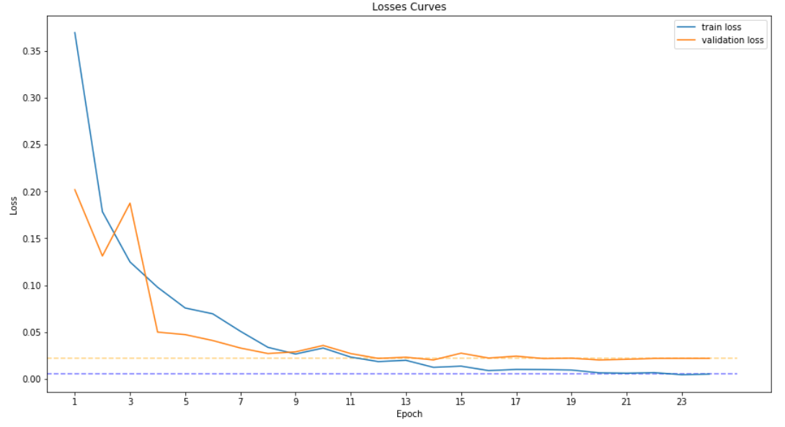
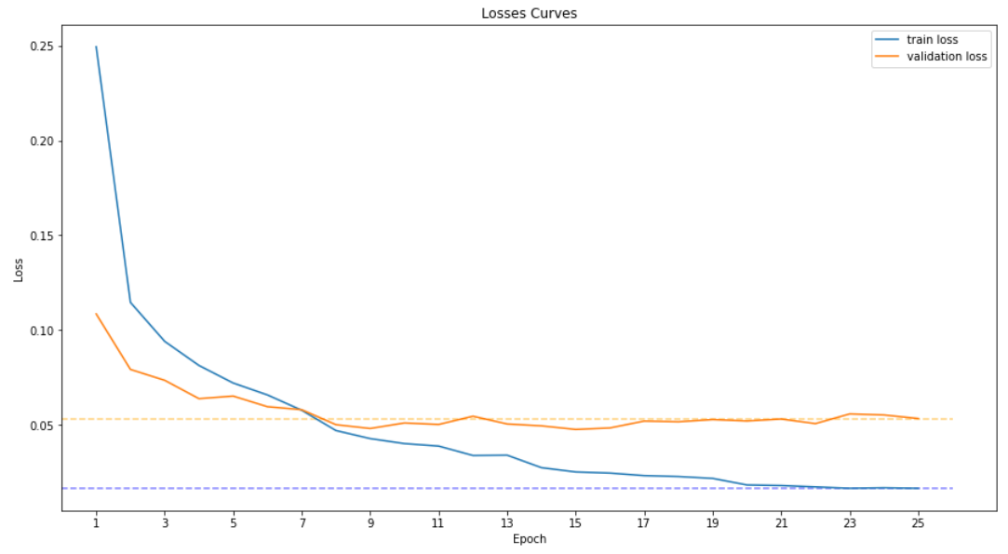
Training and tuning
Arrhythmia task
MI task
test accuracy is: 97.263716%
test accuracy is: 99.415808%
Tuned with optuna
Trained with early stopping
Trained with LR scheduling

Slide 7
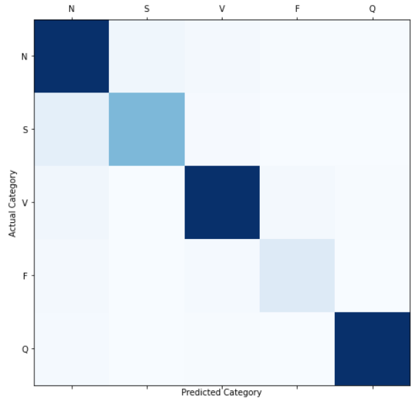
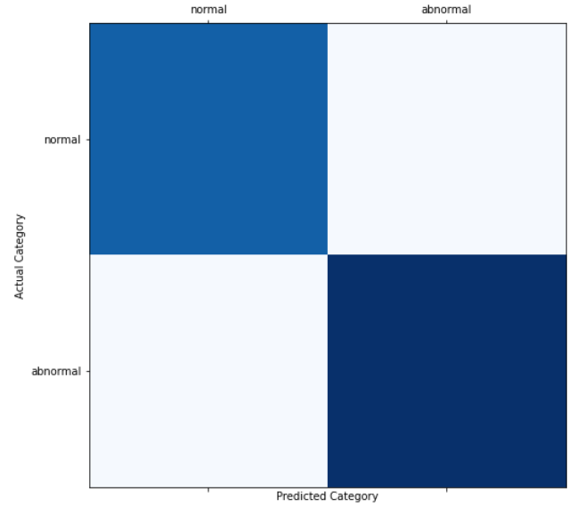
Training and tuning
Confusion matrices
Arrhythmia task
MI task
Tuned with optuna
Trained with early stopping
Trained with LR scheduling

Slide 8
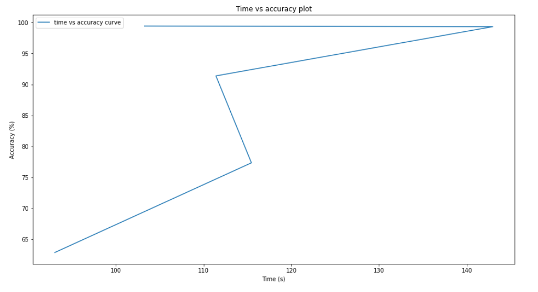
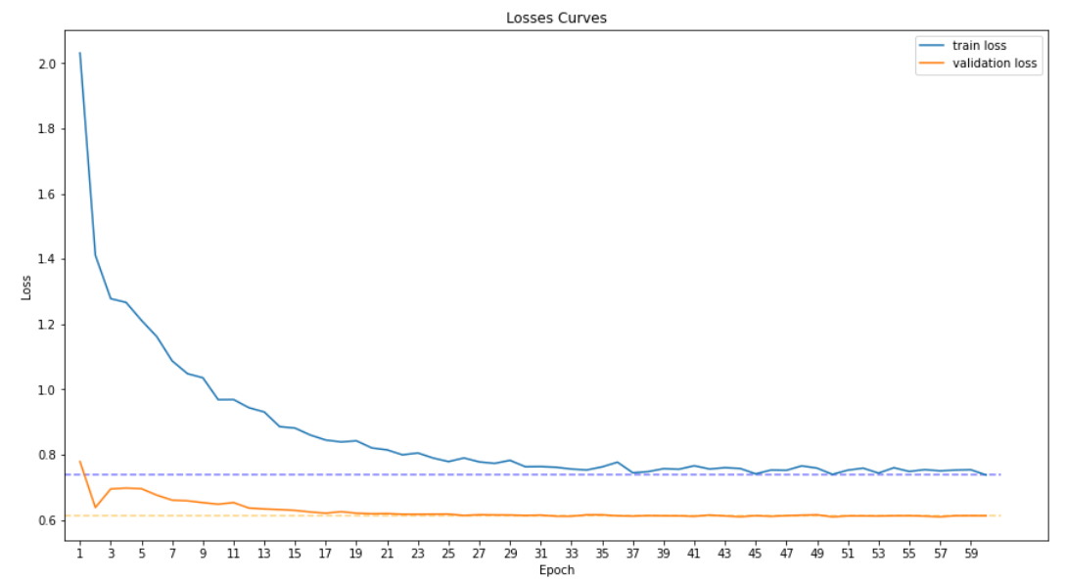
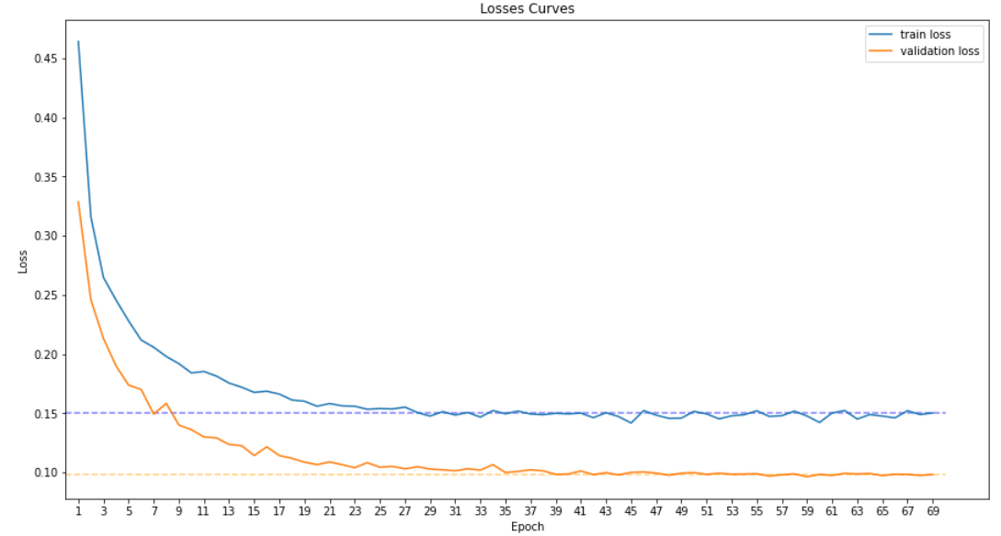
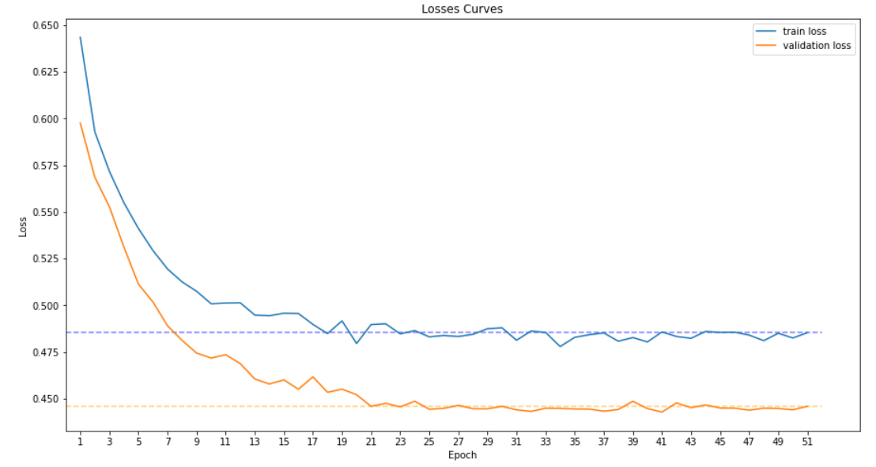
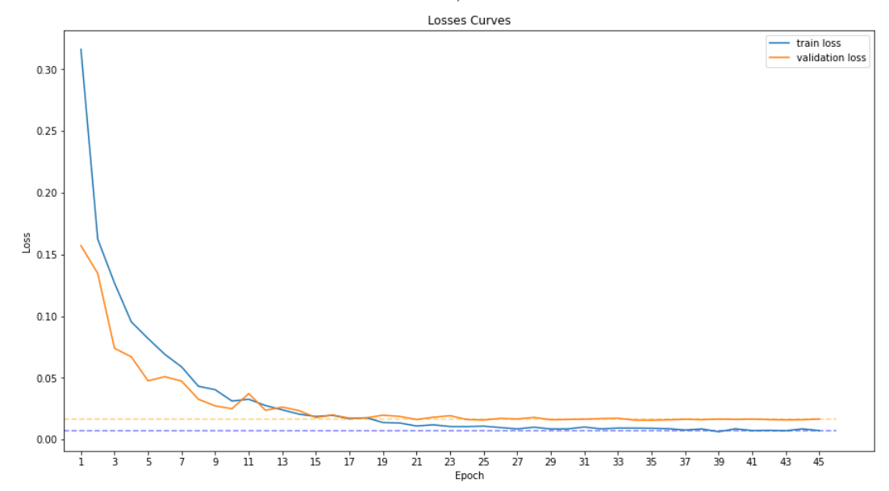
Transferring model –Arrhythmia to MI task
Without transfer
1 layer
3 layers
4 layers
3 layers
2 layers
2 layers
4 layers
1 layer

Slide 9
Comparison of main previous work
source | Model | Test accuracy (weighted by class size)
 |  | MIT-BIH | PTB
Kachuee et Al, 2018 | CNN, 13 layers residuals | 93.4% | 95.9%
FekihRomdhane et Al, 2020 | CNN, 14 layers residuals | 98.6% | X
Sajiddeboss (on Kaggle) | CNN, 14 layers residuals | 98% | X
Previous work (on Kaggle) | CNN, 8 layers | 92.4% | 99.9%
Ours | CNN, 8 layers | 93.8% | 99.21%

Slide 10
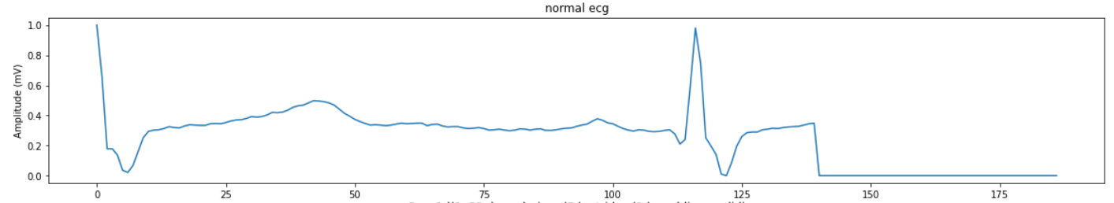
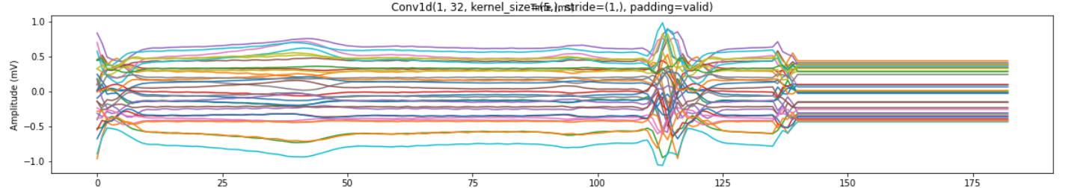
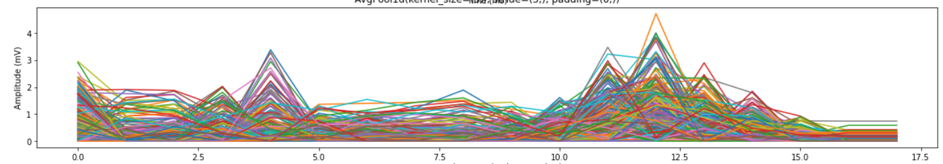
Model explanation

Slide 11
Future work extensions
Check other ECG leads (checked only lead 2#)
Enhancing data to more subjects (these datasets based on 47 subjects)
Generate ECG wavelets for data augmentation
Check the hypothesis that wavelets peaks marker the heart conditions

Slide 12
Thank you for listening

